Slide 1
Software Requirement Engineering Software Engineering Department Spring 2025
Muhammad Huzaifa Shah

Slide 2
Agenda
Introduction to Software Requirement Engineering
Role of requirements in Software Engineering
The main risks of Requirements Engineering
Phases of the Requirements Engineering Process

Slide 3
Software Engineering: Goal
GOAL: to develop quality software
on time and on budget
that meets customers' real needs
A SOFTWARE IS GOOD ONLY IF IT MEETS STAKEHOLDER’S EXPECTATIONS:
it is (at least) correct, reliable, maintainable, user-friendly …
the total cost it incurs over all phases of its life cycle is minimal and within the budget
However, stakeholders are varied!

Slide 4
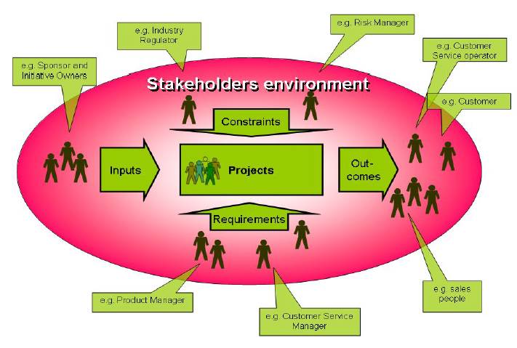
Context: Stakeholders Environment

Slide 5
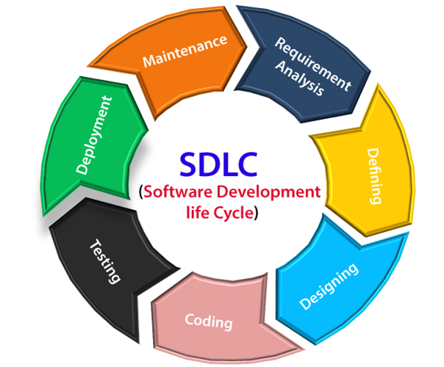
SDLC Seven Phases (1/3)

Slide 6
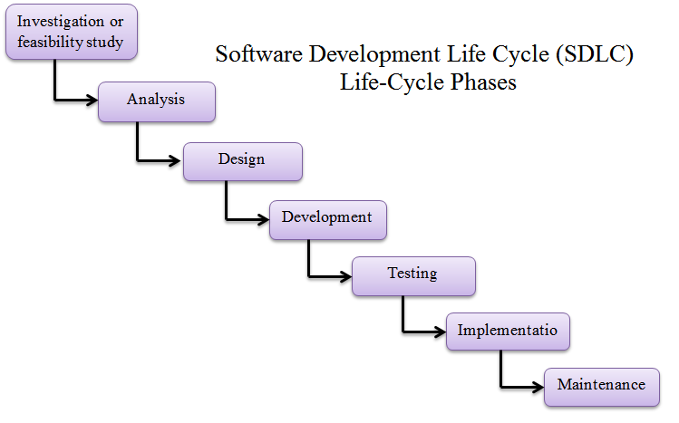
SDLC Seven Phases (1/3)

Slide 7
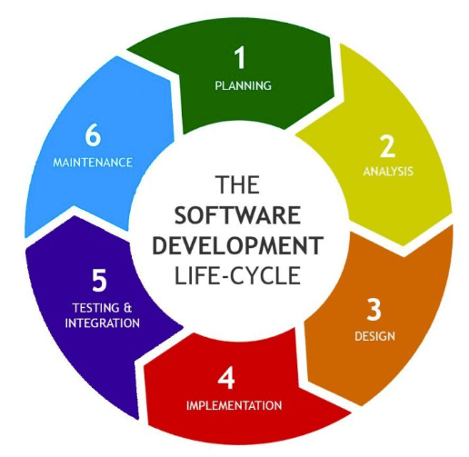
SDLC Six Phases (2/3)

Slide 8
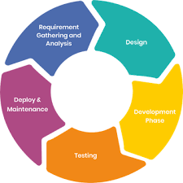
SDLC Five Phases (3/3)

Slide 9
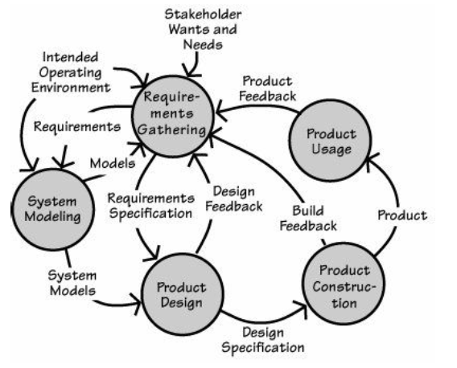
Requirements in the Software Lifecycle

Slide 10
1. Introduction to Software requirement engineering
Software Requirements Engineering is a critical phase in the software development process that focuses on defining, documenting, and managing the needs and expectations of stakeholders for a software system.
It's a systematic and iterative approach to understanding what the software should do, how it should behave, and what constraints it must operate within.

Slide 11
Requirement: Definition
IEEE Standard Glossary of Software Engineering Terminology (1990):
A condition or capability needed by a user to solve a problem or achieve an objective.
A condition or capability that must be met or possessed by a system component to satisfy a contract, standard, specification, or other formally imposed document.
A documented representation of a condition or capability as in 1 or 2.

Slide 12
Requirement: Definition
Sommerville and Sawyer, 1997:
Requirements are…a specification of what should be implemented. They are descriptions of how the system should behave, or of a system property or attribute. They may be a constraint on the development process of the system.

Slide 13
Requirements Engineering: Definition
Zave, 1997:
Requirements engineering is the branch of software engineering concerned with the real- world goals for, functions of, and constraints on software systems.
It is also concerned with the relationship of these factors to precise specifications of software behavior, and to their evolution over time and across software families.

Slide 14
By Proper Requirements Engineering We Can…
know what the system is supposed to do
keep track of the status of requirements
determine the impact of a requirements change

Slide 15
Importance of RE
The hardest single part of building a software system is deciding what to build.
No other part of the conceptual work is so difficult as establishing the detailed technical requirements, including all the interfaces to people, to machines, and to other software systems.
No other part of the work so cripples the resulting system if done wrong.
No other part is more difficult to rectify later.

Slide 16
Importance of RE
“Done well, requirements engineering presents an opportunity to reduce costs and increase the quality of software systems. Done poorly, it could lead to a software project failure.”
Software Engineering Institute (SEI)

Slide 17
Significance
Software requirements serve as the foundation for a successful software project.
They play a pivotal role in ensuring that the end-product meets the needs and expectations of its users and stakeholders.

Slide 18
2. Role of requirements in Software Engineering
Requirement in a Software Engineering Process has following major aspects:
Communication
Guidance for Development
Scope Definition
Project Planning
Quality Assurance

Slide 19
Communication:
Requirements act as a common language between stakeholders, including customers, end-users, project managers, and developers. They help in clarifying and formalizing expectations.
Guidance for Development:
Developers rely on requirements to design, code, and test the software. Well-defined requirements serve as a blueprint for building the system correctly .

Slide 20
Scope Definition:
Requirements help in defining the scope of the project. They specify what features and functionalities will be included and what will be excluded from the final product.
Project Planning:
Requirements are crucial for project planning, resource allocation, and cost estimation. They inform project managers about the complexity and scale of the work.

Slide 21
Quality Assurance:
Requirements are used to create test cases and validation criteria to ensure that the software meets its intended functionality and quality standards.

Slide 22
3. The main risks of Requirements Engineering
Insufficient user involvement
Creeping user requirements
Ambiguous requirements
Gold plating
Inaccurate planning
Overlooked user classes

Slide 23
1. Insufficient User Involvement
Example:
A software development team is building a new e-commerce website without consulting actual users or conducting usability tests. As a result, the final product lacks essential features that customers expect, leading to poor user satisfaction and limited sales.

Slide 24
2. Creeping User Requirements
Example:
A project to develop a mobile app for a fitness tracker initially had well-defined requirements. However, as the project progressed, stakeholders continuously added new features and modifications, causing scope creep and delays.

Slide 25
3. Ambiguous Requirements
Example:
In a software project for a financial institution, the requirement states, "The system should handle large transactions efficiently." Without a clear definition of what "large transactions?" mean, the development team faces difficulties in designing an appropriate solution, leading to misunderstandings and potential performance issues.

Slide 26
4. Gold Plating
Example:
A developer decides to add numerous fancy animations, complex graphics, and extra features to a simple note-taking app, even though these additions were not requested by users or stakeholders.
This unnecessary "gold plating" results in increased development time and resources without adding significant value to the application.

Slide 27
5. Inaccurate Planning
Example:
A project manager underestimates the time and resources required to complete a software project.
The team ends up missing deadlines, making rushed decisions, and producing a subpar product due to inadequate planning and resource allocation.

Slide 28
6. Overlooked User Classes
Example:
In the development of an online learning platform, the team focuses primarily on the needs of students but neglects to consider the requirements of teachers or administrators who will use the system to manage courses and assignments.
This oversight leads to usability issues and
dissatisfaction among educators.

Slide 29
4. Phases of the Requirements Engineering Process

Slide 30
Requirements Development Process
Elicitation: work with the customer on gathering requirements
Analysis: process this information to understand it, classify in various categories, and relate the customer needs to possible software requirements
Specification: Structure the customer input and derived requirements as written documents and diagrams
Validation: you’ll ask your customer to confirm that what you’ve written is accurate and complete and to correct errors

Slide 31
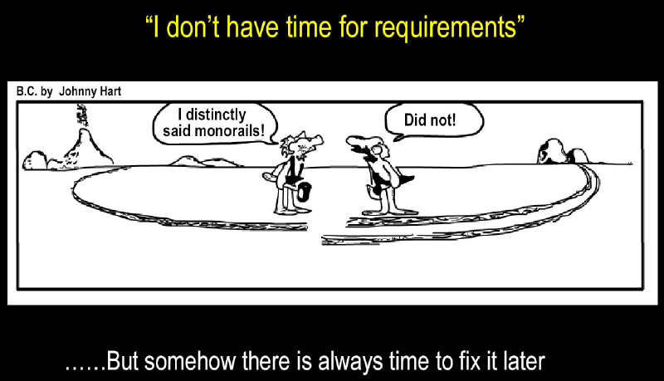
Why Requirements are Important?

